Slide 1
Artificial Intelligence for Games Week 6 – Terrain Analysis Steve Rabin
For help on projects, email everyone (select and copy this string from the start of any class PowerPoint):
steve.rabin@gmail.com, p.jiankai@digipen.edu, b.hsu@digipen.edu, zak.s@digipen.edu, keaton.sullivan@digipen.edu, john.tseng@digipen.edu, a.roulst@digipen.edu
TAs: Jian Kai Phua, Brandon Hsu, Zak Stephenson, Keaton Sullivan, John Tseng, Andrew Roulst

Slide 2
Questions
In JPS+, jumping accounts for 50% of the speed up. What accounts for the other 50%?
What is the difference between JPS and JPS+?
What are the restrictions of JPS+?
In Goal Bounding, what is stored on every node edge?
Which search space representations can be used with Goal Bounding?
Which search algorithms can Goal Bounding be added to?

Slide 4
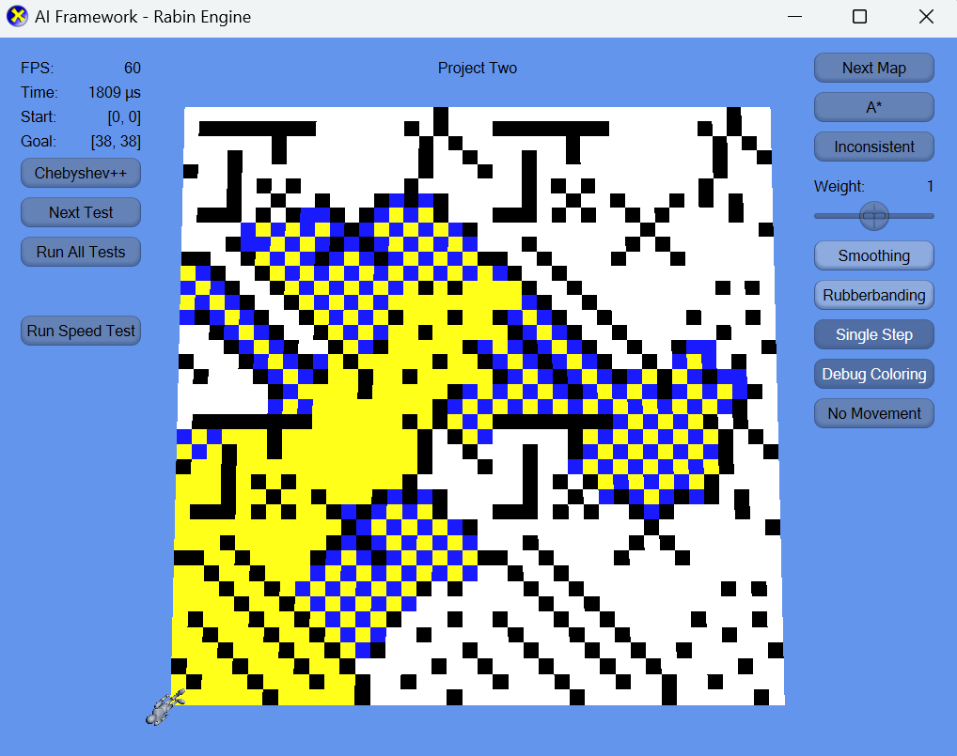
Inconsistent Heuristic Example
Use this code in your project for the inconsistent heuristic
if ((cur.row + cur.col) % 2 > 0) {
return <Euclidean calculation>;
}
else {
return 0;
}
You know it’s working if you
see the checkerboard pattern!
The tests do not test for the checkerboard pattern, but it is required!

Slide 5
A* Algorithm
If (request.newRequest) {
Initialize everything. Clear Open/Closed Lists.
Push Start Node onto the Open List with cost of f(x) = g(x) + h(x).
}
While (Open List is not empty) {
parentNode = Pop cheapest node off Open List.
If parentNode is the Goal Node, then path found (return PathResult::COMPLETE).
Place parentNode on the Closed List.
For (all neighboring child nodes of parentNode) {
Compute its cost, f(x) = g(x) + h(x)
If child node isn’t on Open or Closed list, put it on Open List.
Else if child node is on Open or Closed List, AND this new one is cheaper,
then take the old expensive one off both lists and put this new
cheaper one on the Open List.
}
If taken too much time this frame (or if request.settings.singleStep == true),
abort search for now and resume next frame (return PathResult::PROCESSING).
}
Open List empty, thus no path possible (return PathResult::IMPOSSIBLE).
Required for Inconsistent heuristic to work and pass the tests!

Slide 6
Need help with Project 2?
Email:
steve.rabin@gmail.com, p.jiankai@digipen.edu, b.hsu@digipen.edu, zak.s@digipen.edu, keaton.sullivan@digipen.edu, john.tseng@digipen.edu, a.roulst@digipen.edu
Things you can ask:
I don’t understand and need clarification.
I’m stuck on a bug. Here is everything I know about this bug and what I’m thinking. Here is a link to my project.
I don’t understand and want to meet with a TA. I’m available on Tues 1-5pm.

Slide 7
Terrain Analysis
Algorithmic analysis of terrain
Automated with no human intervention
Alternative to hard-coding regions of interest
In general:
Are there spots on the terrain that are advantageous?
How can these be determined algorithmically?

Slide 8
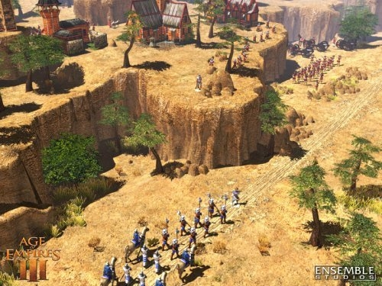
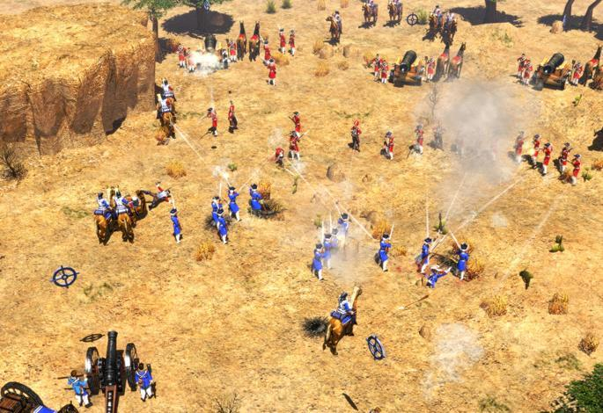
RTS: Static/Dynamic Points of Interest

Slide 9
RTS: Static/Dynamic Points of Interest
Chokepoints
Barriers force units through narrow path
Barriers can be cliffs, walls, water, etc.
Ambush sites
High terrain overlooking low terrain chokepoint
Wall building sites
Low cost for building walls
Natural barriers so not much wall required
Cliffs, Water, Edge of map
Resources
Identify front of the battle
Identify flanking routes
Identify inferior forces

Slide 10
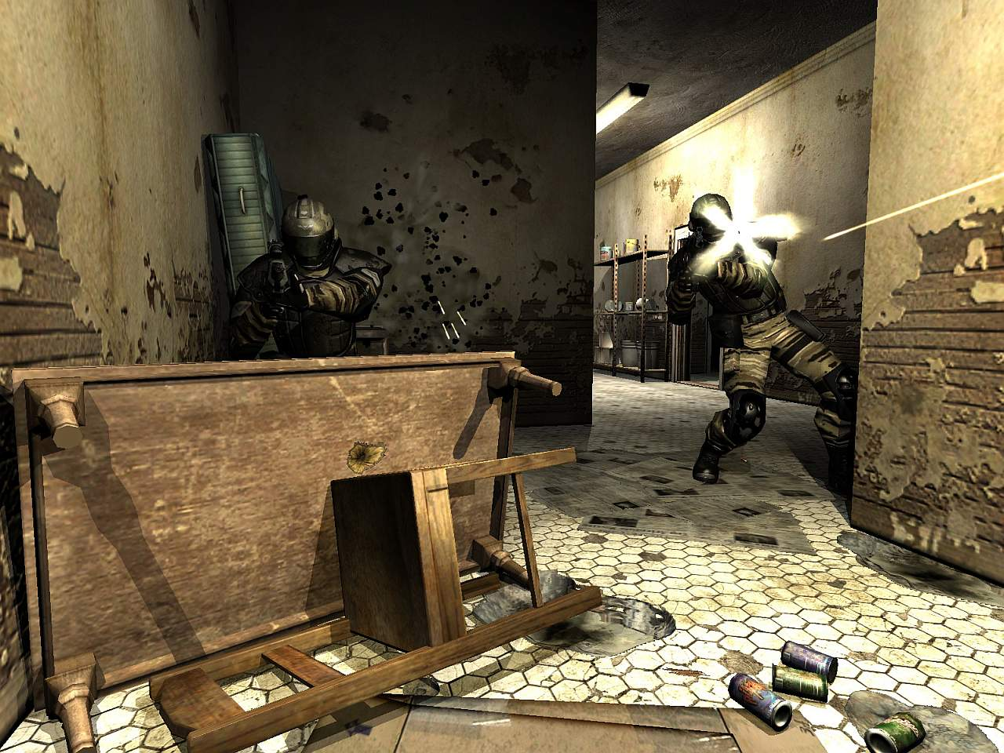
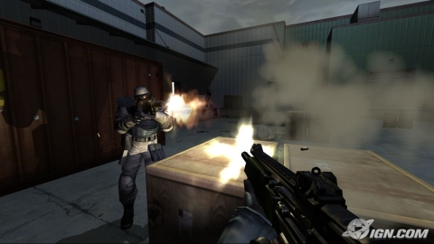
FPS: Static/Dynamic Points of Interest

Slide 11
FPS: Static/Dynamic Points of Interest
Cover points
Shielding
Darkness
Sniper points
Good cover point (shielding, darkness)
Potential high visibility to a large area
Rear coverage
Height advantage
Escape route
Safe paths
Low casualties in path
Low visibility to other areas
Good cover along path
Line-of-sight vulnerability
Stay out of other's line-of-sight

Slide 12
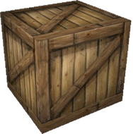
Visibility is a Good Tactical Indicator
Does a spot provide cover?
Front cover and rear cover?
How safe is it?
Does a spot provide accessibility?
Is a given spot good to shoot from?
Can we escape easily?
How dangerous is it?

Slide 13
Half-Life 2: Tactical Reasoning with Waypoints
Preprocess terrain, storing visibility info
Can area A see area B?
Store visibility info in waypoint nodes
Node A’s ability to see every other node

Slide 14
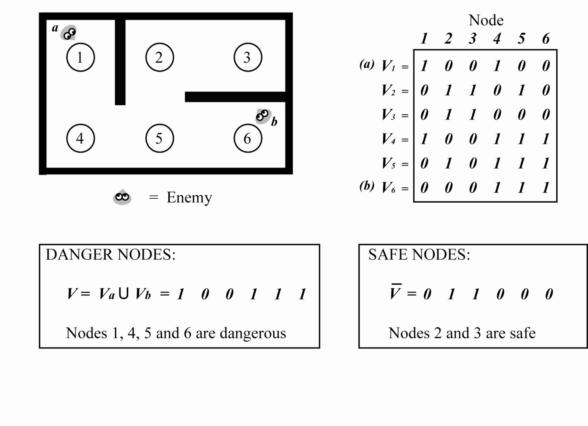

Slide 15
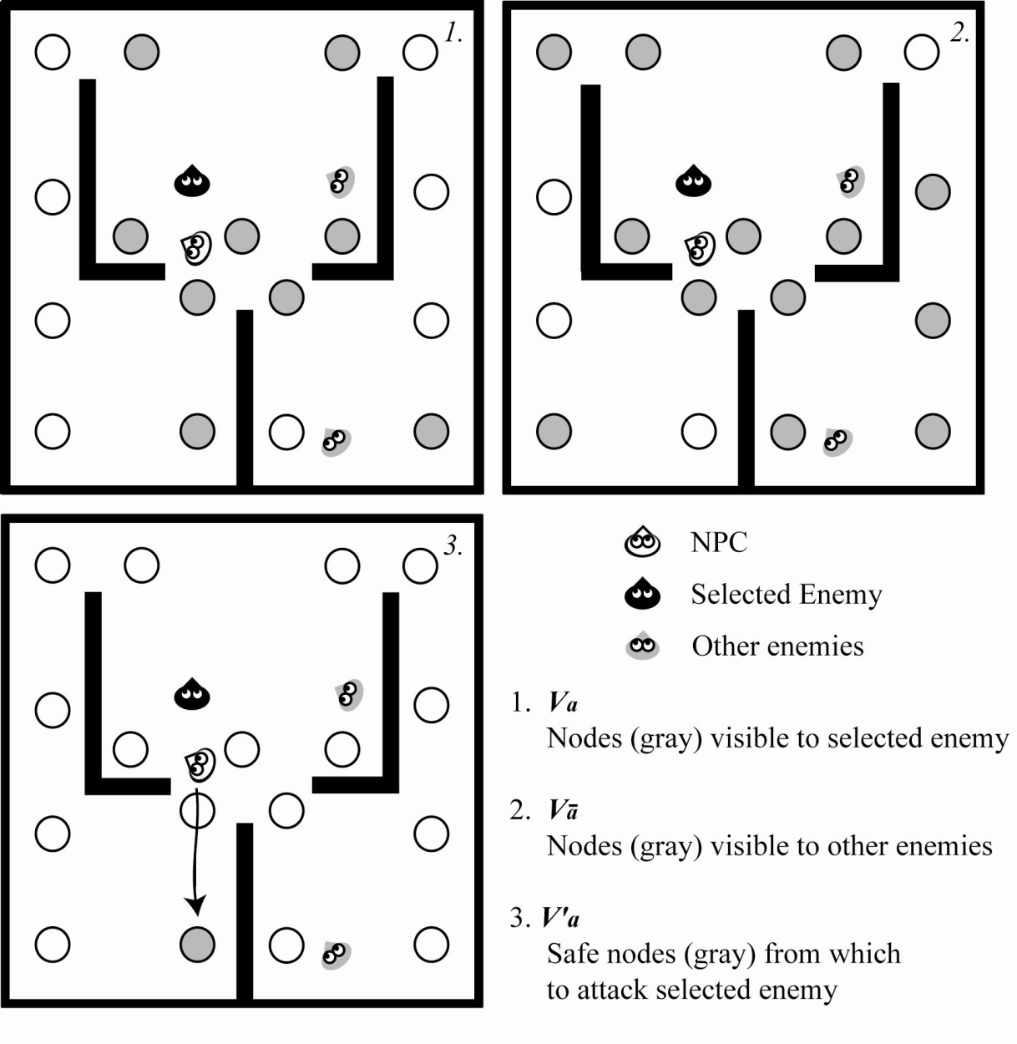

Slide 16
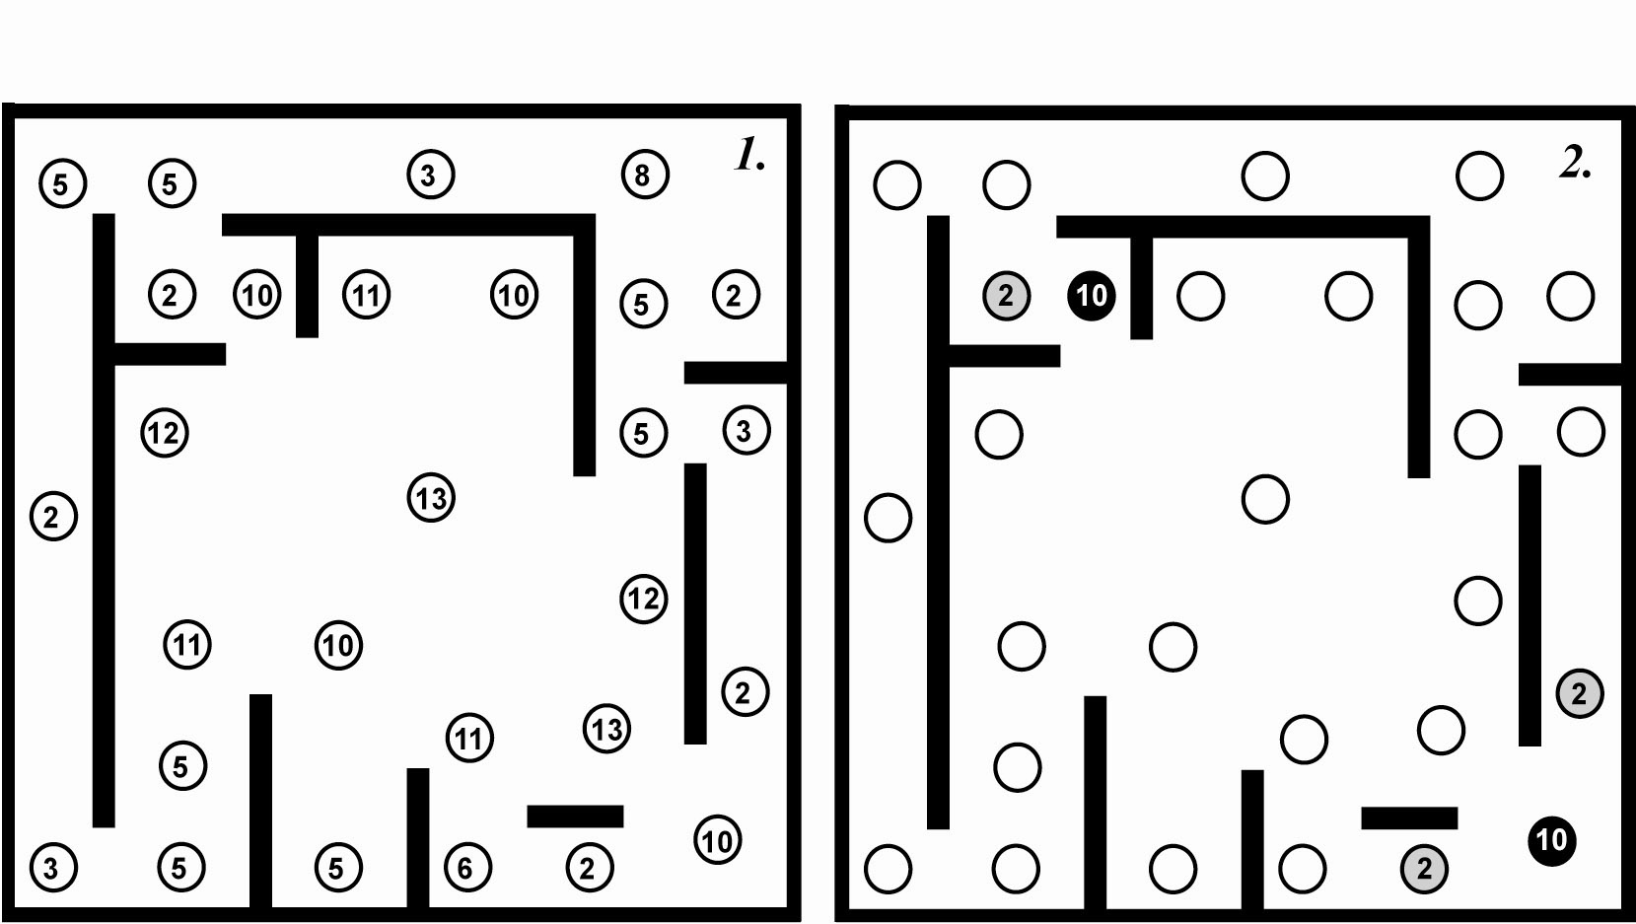

Slide 17
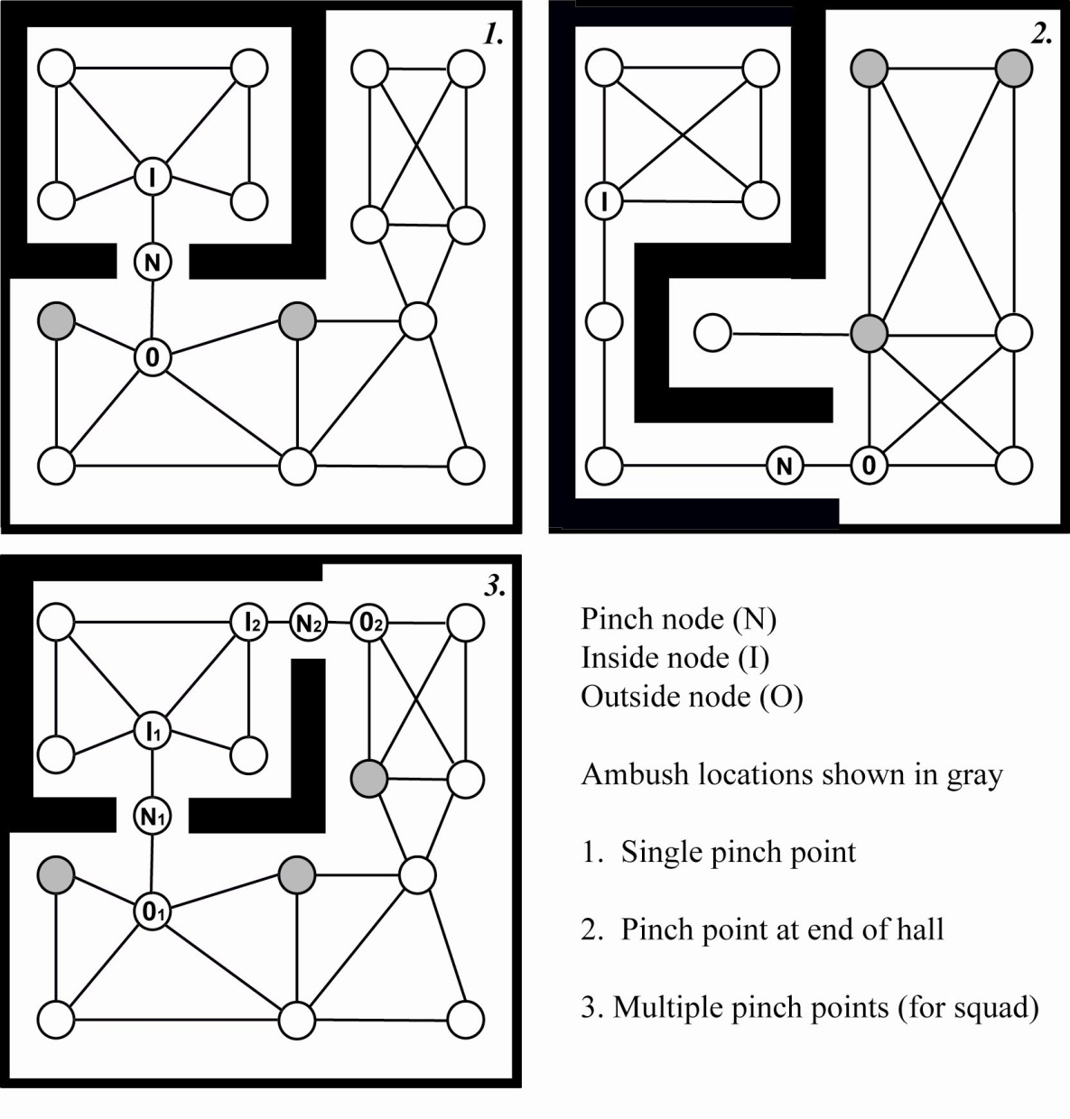

Slide 18
Influence Mapping

Slide 19
Influence Mapping
Abstraction: Distribution of power
2D grid superimposed on terrain
Unit strength is summed into grid cells
Influence declines with distance (1 / d²)
Helps determine
Weaknesses
Neutral routes to flank enemy
The “front” of the battle

Slide 22
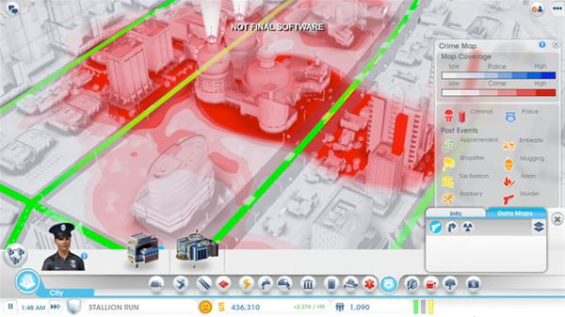

Slide 23
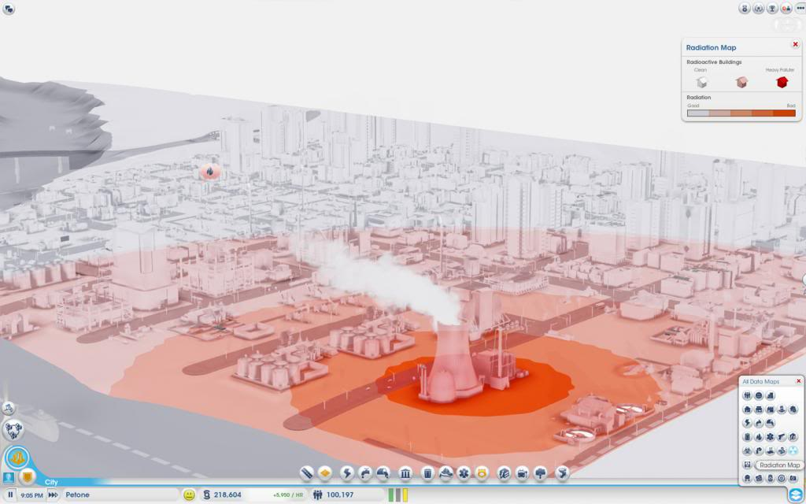

Slide 24
Generalized Grid Terrain Analysis
Capture many different analysis techniques on a grid
Visibility aspects from Half-Life 2 technique
Distribution of power from influence maps
Similar to SimCity variations

Slide 25
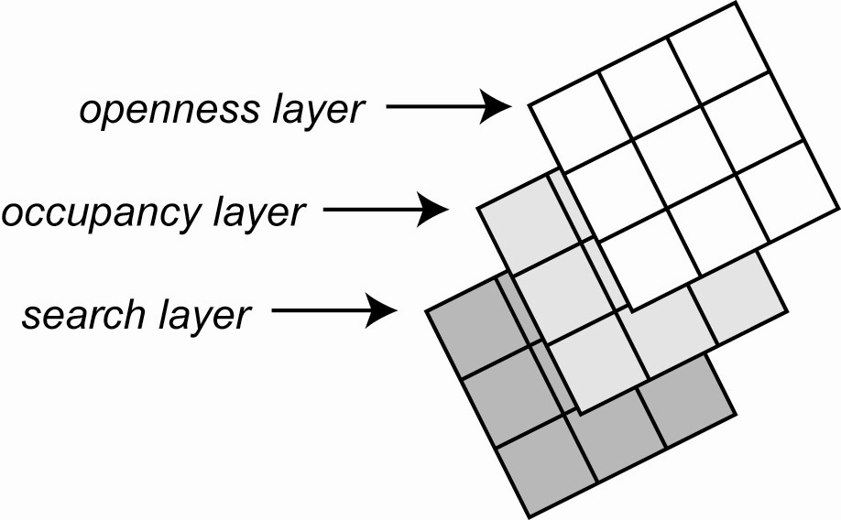

Slide 26
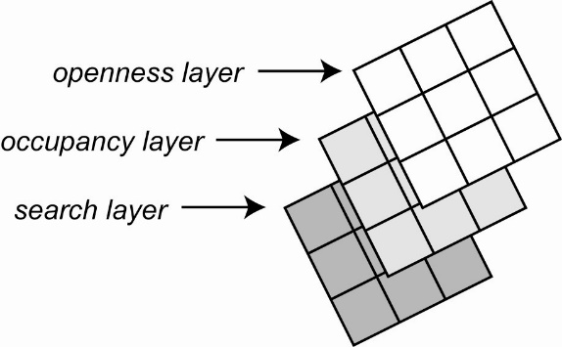
Many Layers
Visibility
How many squares are visible
Openness layer
Proximity to static obstacles
Cover layer
Locations where AI can take cover from gunfire
Area occupancy layer
Number of units in an area
Line-of-fire layer
Direction that weapons are being aimed
Light level layer
Brightness or darkness of any spot
Area search layer
Spots that have been searched
Occupancy map
Probability of where the player is

Slide 27
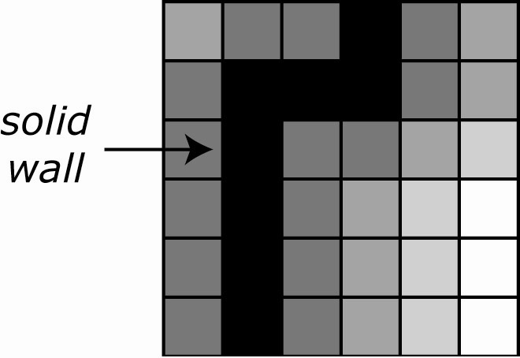
Openness Layer

Slide 28
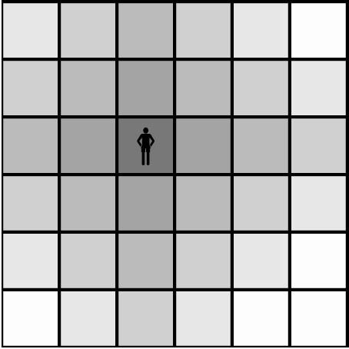
Area Occupancy Layer

Slide 29
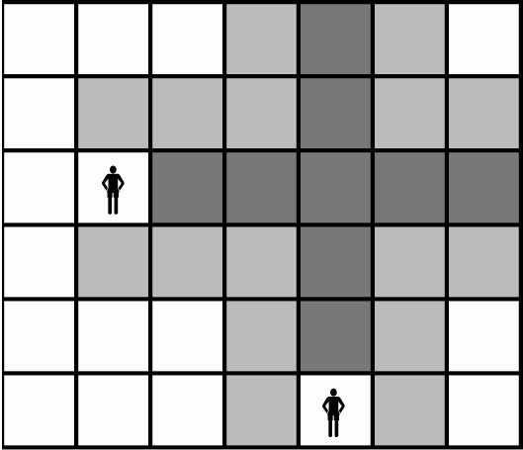
Line-of-Sight Layer

Slide 30
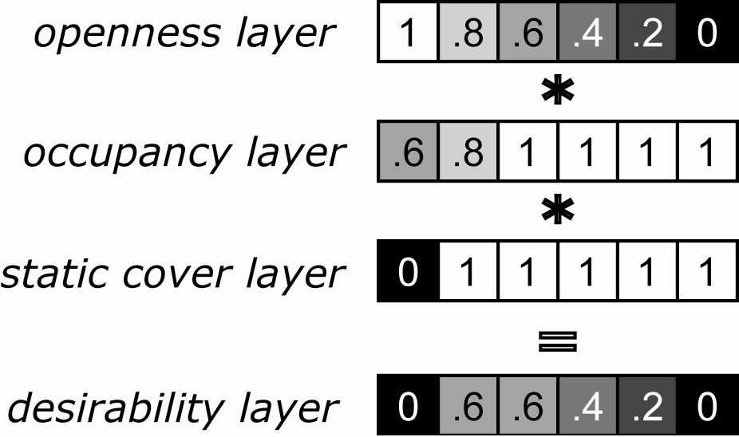
Combine Layers: Combat Desirability Layer

Slide 31
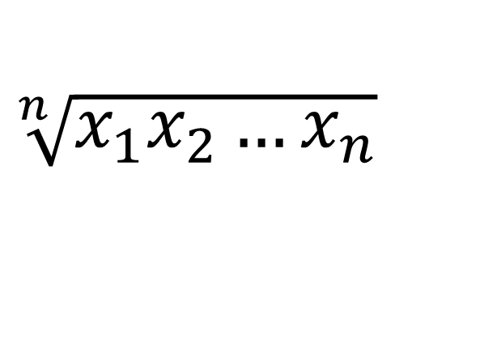
Geometric Mean Correct way to combine utility or influence values
VALUES | MULTIPLIED | MEAN | GEOMETRIC MEAN
0.9 | 0.9 | 0.9 | 0.9
0.9, 0.9 | 0.81 | 0.9 | 0.9
0.9, 0.9, 0.9, 0.9 | 0.6561 | 0.9 | 0.9
0.1, 0.1, 0.1, 0.9 | 0.0009 | 0.3 | 0.173
0.8, 0.5, 0.2 | 0.08 | 0.5 | 0.43
1.0, 1.0, 1.0 | 1 | 1 | 1
0, 1.0, 1.0 | 0 | 0.667 | 0

Slide 32
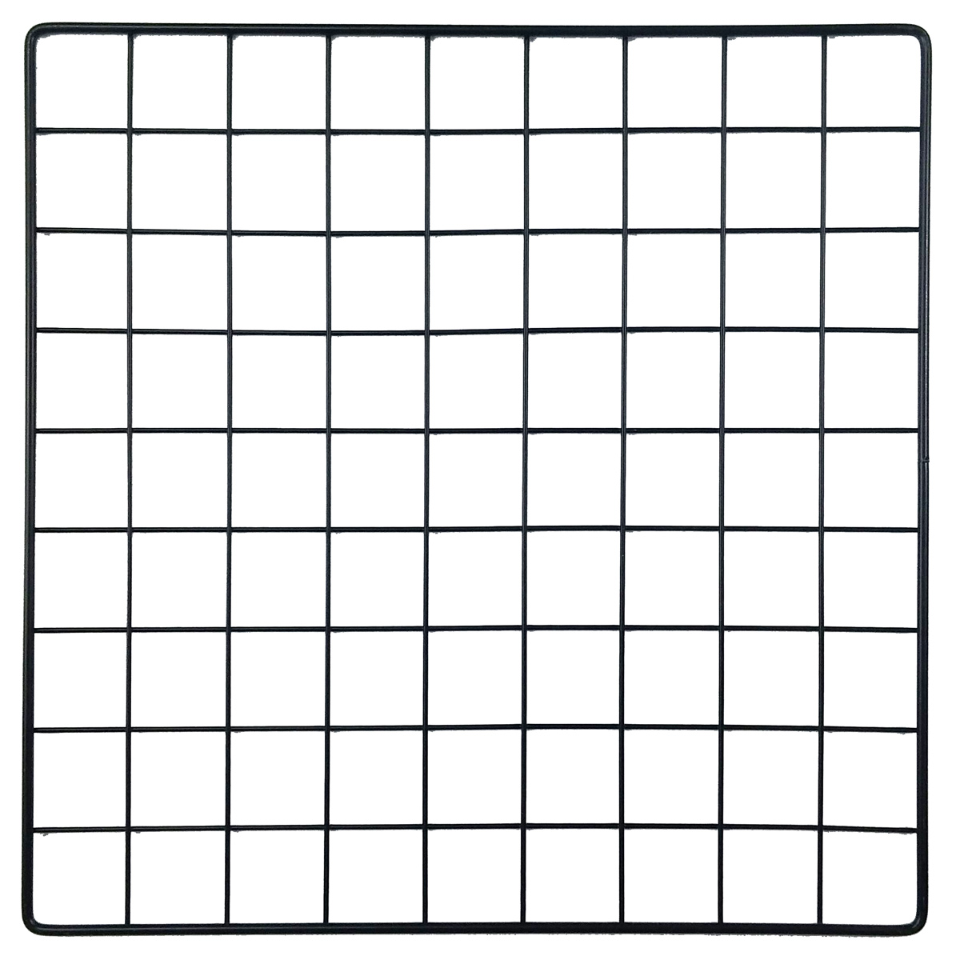
Project 3: LOS Calculation
bool line_intersect(const Vec2 &line0P0, const Vec2 &line0P1, const Vec2 &line1P0, const Vec2 &line1P1);

Slide 33
Project 3: LOS Calculation
bool line_intersect(const Vec2 &line0P0, const Vec2 &line0P1, const Vec2 &line1P0, const Vec2 &line1P1);

Slide 34
Project 3: LOS Calculation
bool line_intersect(const Vec2 &line0P0, const Vec2 &line0P1, const Vec2 &line1P0, const Vec2 &line1P1);

Slide 35
Project 3: LOS Calculation
bool line_intersect(const Vec2 &line0P0, const Vec2 &line0P1, const Vec2 &line1P0, const Vec2 &line1P1);

Slide 36
Project 3: LOS Calculation
bool line_intersect(const Vec2 &line0P0, const Vec2 &line0P1, const Vec2 &line1P0, const Vec2 &line1P1);

Slide 37
Project 3: LOS Calculation
bool line_intersect(const Vec2 &line0P0, const Vec2 &line0P1, const Vec2 &line1P0, const Vec2 &line1P1);

Slide 38
Project 3: LOS Calculation
bool line_intersect(const Vec2 &line0P0, const Vec2 &line0P1, const Vec2 &line1P0, const Vec2 &line1P1);

Slide 39
Project 3: LOS Calculation
bool line_intersect(const Vec2 &line0P0, const Vec2 &line0P1, const Vec2 &line1P0, const Vec2 &line1P1);

Slide 40
Project 3 Grading
(15%) Openness Closest Wall
(15%) Visibility
(15%) Visible to Player (with 50% sniper spots)
(15%) Search
Occupancy Map:
(20%) Propagation + Normalize Occupancy
(5%) Field of View (Hide and Seek)
(5%) Find Player (Hide and Seek)
(10%) Seek Player (Hide and Seek)
(-10%) If it crashes at any time
(0 to -100%) Project 2 requirements regraded (except time requirements)
(extra credit) All Project 2 extra credit still available

Slide 41
Occupancy Maps
Occupancy Map Demo (GDC 2009)
https://www.youtube.com/watch?v=5lBye82qUog
Third Eye Crime
https://www.youtube.com/watch?v=x_Gkc1787kA
https://www.youtube.com/watch?v=TNu2qJ4I83E

Slide 42

OCCUPANCY MAP FRAMEWORK

Slide 43
Propagation Algorithm: Pseudo Code
For each tile on the map
Get the influence value of each neighbor after decay
Keep the maximum decayed influence value of all neighbors
Apply linear interpolation to the influence value of the tile, and the maximum decayed influence value from all neighbors, with growing factor as coefficient
Store the result to the temp layer
Store influence value from temp layer
Influence Layer
Temp Layer
0.00
0.00
0.00
0.00
1.00
0.00
0.00
0.00
0.00
0.00
0.00
0.00
0.00
0.00
0.00
0.00
0.00
0.00

Slide 44
Propagation Algorithm: Pseudo Code
For each tile on the map
Get the influence value of each neighbor after decay
Keep the maximum decayed influence value of all neighbors
Apply linear interpolation to the influence value of the tile, and the maximum decayed influence value from all neighbors, with growing factor as coefficient
Store the result to the temp layer
Store influence value from temp layer
Influence Layer
Temp Layer
0.00
0.00
0.00
0.00
1.00
0.00
0.00
0.00
0.00
0.00
0.00
0.00
0.00
0.00
0.00
0.00
0.00
0.00

Slide 45
Propagation Algorithm: Pseudo Code
For each tile on the map
Get the influence value of each neighbor after decay
Keep the maximum decayed influence value of all neighbors
Apply linear interpolation to the influence value of the tile, and the maximum decayed influence value from all neighbors, with growing factor as coefficient
Store the result to the temp layer
Store influence value from temp layer
Influence Layer
Temp Layer
0.00
0.00
0.00
0.00
1.00
0.00
0.00
0.00
0.00
0.23
0.25
0.23
0.25
0.70
0.23
0.25
0.23
0.25

Slide 46
Propagation Algorithm: Pseudo Code
For each tile on the map
Get the influence value of each neighbor after decay
Keep the maximum decayed influence value of all neighbors
Apply linear interpolation to the influence value of the tile, and the maximum decayed influence value from all neighbors, with growing factor as coefficient
Store the result to the temp layer
Store influence value from temp layer
Influence Layer
Temp Layer
0.23
0.25
0.23
0.25
0.70
0.23
0.23
0.25
0.25
0.23
0.25
0.23
0.25
0.70
0.23
0.25
0.23
0.25

Slide 47
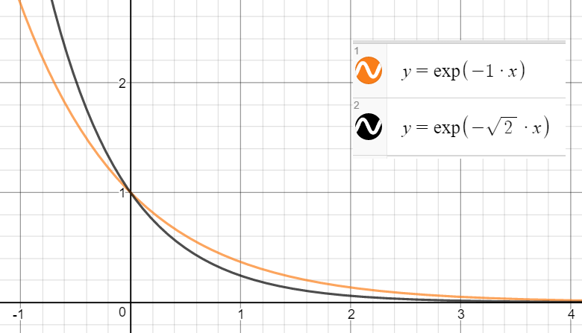
Propagation Algorithm Parameters: Decay Formula
Decay | Distance | Old Influence | New Influence
0.00 | 1.00 | 1.00 | 1.00
0.20 | 1.00 | 1.00 | 0.82
0.40 | 1.00 | 1.00 | 0.67
0.60 | 1.00 | 1.00 | 0.55
0.80 | 1.00 | 1.00 | 0.45
1.00 | 1.00 | 1.00 | 0.37
1.20 | 1.00 | 1.00 | 0.30
1.40 | 1.00 | 1.00 | 0.25
1.60 | 1.00 | 1.00 | 0.20
1.80 | 1.00 | 1.00 | 0.17
2.00 | 1.00 | 1.00 | 0.14
Exponential Decay Formula
New_Influence =
Old_Influence * exp(-1 * Distance * Decay_Factor)
Decay Factor
How quickly the influence decays with distance
Influence fades out faster with a higher decay factor

Slide 48
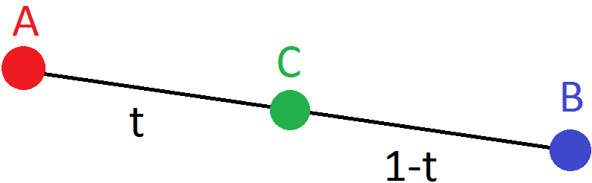
Propagation Algorithm Parameters: Linear Interpolation Formula
Growing Factor
When updating the influence value, how much to bias the update towards the existing value compared to the new value
In the closed unit interval [0, 1]
Linear Interpolation Formula
New_Influence = (1 – Growing_Coefficient) * Old_Influence + Growing_Coefficient * Max_Neighbor_Influence
Propagation happens quicker with lower growing value
Old Influence | Neighbor Influence | Growing | New Influence
1.00 | 0.50 | 0.00 | 1.00
1.00 | 0.50 | 0.10 | 0.95
1.00 | 0.50 | 0.20 | 0.90
1.00 | 0.50 | 0.30 | 0.85
1.00 | 0.50 | 0.40 | 0.80
1.00 | 0.50 | 0.50 | 0.75
1.00 | 0.50 | 0.60 | 0.70
1.00 | 0.50 | 0.70 | 0.65
1.00 | 0.50 | 0.80 | 0.60
1.00 | 0.50 | 0.90 | 0.55
1.00 | 0.50 | 1.00 | 0.50

Slide 49

Propagation Algorithm Parameters: Update Frequency
How often to update the influence map
Better to have a tweakable time for debugging purposes
No need to be updating at 30fps in most cases

Slide 50
Propagation Algorithm: Pseudo Code
For each tile on the map
Get the influence value of each neighbor after decay
Keep the maximum decayed influence value of all neighbors
Apply linear interpolation to the influence value of the tile, and the maximum decayed influence value from all neighbors, with growing factor as coefficient
Store the result to the temp layer
Store influence value from temp layer
Influence Layer
Temp Layer
decay factor: 0.2, growing factor: 0.3
0.00
0.00
0.00
0.00
1.00
0.00
0.00
0.00
0.00
0.00
0.00
0.00
0.00
0.00
0.00
0.00
0.00
0.00

Slide 51
Propagation Algorithm: Pseudo Code
For each tile on the map
Get the influence value of each neighbor after decay
Keep the maximum decayed influence value of all neighbors
Apply linear interpolation to the influence value of the tile, and the maximum decayed influence value from all neighbors, with growing factor as coefficient
Store the result to the temp layer
Store influence value from temp layer
Influence Layer
Temp Layer
decay factor: 0.2, growing factor: 0.3
neighbor influences:
R – 0 * exp(-1 * 0.2) = 0
B – 0 * exp(-1 * 0.2) = 0
BR – 1 * exp(-sqrt(2) * 0.2) = 0.75
0.00
0.00
0.00
0.00
1.00
0.00
0.00
0.00
0.00
0.00
0.00
0.00
0.00
0.00
0.00
0.00
0.00
0.00

Slide 52
Propagation Algorithm: Pseudo Code
For each tile on the map
Get the influence value of each neighbor after decay
Keep the maximum decayed influence value of all neighbors
Apply linear interpolation to the influence value of the tile, and the maximum decayed influence value from all neighbors, with growing factor as coefficient
Store the result to the temp layer
Store influence value from temp layer
Influence Layer
Temp Layer
decay factor: 0.2, growing factor: 0.3
neighbor influences:
R – 0 * exp(-1 * 0.2) = 0
B – 0 * exp(-1 * 0.2) = 0
BR – 1 * exp(-sqrt(2) * 0.2) = 0.75 **MAX**
0.00
0.00
0.00
0.00
1.00
0.00
0.00
0.00
0.00
0.00
0.00
0.00
0.00
0.00
0.00
0.00
0.00
0.00

Slide 53
Propagation Algorithm: Pseudo Code
For each tile on the map
Get the influence value of each neighbor after decay
Keep the maximum decayed influence value of all neighbors
Apply linear interpolation to the influence value of the tile, and the maximum decayed influence value from all neighbors, with growing factor as coefficient
Store the result to the temp layer
Store influence value from temp layer
Influence Layer
Temp Layer
decay factor: 0.2, growing factor: 0.3
max neighbor influence: 0.75
lerp(0, 0.75, 0.3) =
(1-0.3)*0 + 0.3*0.75 = 0.23
0.00
0.00
0.00
0.00
1.00
0.00
0.00
0.00
0.00
0.00
0.00
0.00
0.00
0.00
0.00
0.00
0.00
0.00

Slide 54
Propagation Algorithm: Pseudo Code
For each tile on the map
Get the influence value of each neighbor after decay
Keep the maximum decayed influence value of all neighbors
Apply linear interpolation to the influence value of the tile, and the maximum decayed influence value from all neighbors, with growing factor as coefficient
Store the result to the temp layer
Store influence value from temp layer
Influence Layer
Temp Layer
decay factor: 0.2, growing factor: 0.3
max neighbor influence: 0.75
lerp(0, 0.75, 0.3) =
(1-0.3)*0 + 0.3*0.75 = 0.23
0.00
0.00
0.00
0.00
1.00
0.00
0.00
0.00
0.00
0.00
0.00
0.23
0.00
0.00
0.00
0.00
0.00
0.00

Slide 55
Propagation Algorithm: Pseudo Code
For each tile on the map
Get the influence value of each neighbor after decay
Keep the maximum decayed influence value of all neighbors
Apply linear interpolation to the influence value of the tile, and the maximum decayed influence value from all neighbors, with growing factor as coefficient
Store the result to the temp layer
Store influence value from temp layer
Influence Layer
Temp Layer
decay factor: 0.2, growing factor: 0.3
0.00
0.00
0.00
0.00
1.00
0.00
0.00
0.00
0.00
0.00
0.00
0.23
0.00
0.00
0.00
0.00
0.00
0.00

Slide 56
Propagation Algorithm: Pseudo Code
For each tile on the map
Get the influence value of each neighbor after decay
Keep the maximum decayed influence value of all neighbors
Apply linear interpolation to the influence value of the tile, and the maximum decayed influence value from all neighbors, with growing factor as coefficient
Store the result to the temp layer
Store influence value from temp layer
Influence Layer
Temp Layer
decay factor: 0.2, growing factor: 0.3
max neighbor influence:
B - 1 * exp(-1* 0.2) = 0.82
0.00
0.00
0.00
0.00
1.00
0.00
0.00
0.00
0.00
0.00
0.00
0.23
0.00
0.00
0.00
0.00
0.00
0.00

Slide 57
Propagation Algorithm: Pseudo Code
For each tile on the map
Get the influence value of each neighbor after decay
Keep the maximum decayed influence value of all neighbors
Apply linear interpolation to the influence value of the tile, and the maximum decayed influence value from all neighbors, with growing factor as coefficient
Store the result to the temp layer
Store influence value from temp layer
Influence Layer
Temp Layer
decay factor: 0.2, growing factor: 0.3
max neighbor influence: 0.82
lerp(0, 0.82, 0.3) =
(1-0.3)*0 + 0.3*0.82 = 0.25
0.00
0.00
0.00
0.00
1.00
0.00
0.00
0.00
0.00
0.00
0.00
0.23
0.00
0.00
0.00
0.00
0.00
0.00

Slide 58
Propagation Algorithm: Pseudo Code
For each tile on the map
Get the influence value of each neighbor after decay
Keep the maximum decayed influence value of all neighbors
Apply linear interpolation to the influence value of the tile, and the maximum decayed influence value from all neighbors, with growing factor as coefficient
Store the result to the temp layer
Store influence value from temp layer
Influence Layer
Temp Layer
decay factor: 0.2, growing factor: 0.3
max neighbor influence: 0.82
lerp(0, 0.82, 0.3) =
(1-0.3)*0 + 0.3*0.82 = 0.25
0.00
0.00
0.00
0.00
1.00
0.00
0.00
0.00
0.00
0.00
0.00
0.23
0.00
0.00
0.00
0.25
0.00
0.00

Slide 59
Propagation Algorithm: Pseudo Code
For each tile on the map
Get the influence value of each neighbor after decay
Keep the maximum decayed influence value of all neighbors
Apply linear interpolation to the influence value of the tile, and the maximum decayed influence value from all neighbors, with growing factor as coefficient
Store the result to the temp layer
Store influence value from temp layer
Influence Layer
Temp Layer
decay factor: 0.2, growing factor: 0.3
0.00
0.00
0.00
0.00
1.00
0.00
0.00
0.00
0.00
0.23
0.25
0.23
0.25
0.70
0.23
0.25
0.23
0.25

Slide 60
Propagation Algorithm: Pseudo Code
For each tile on the map
Get the influence value of each neighbor after decay
Keep the maximum decayed influence value of all neighbors
Apply linear interpolation to the influence value of the tile, and the maximum decayed influence value from all neighbors, with growing factor as coefficient
Store the result to the temp layer
Store influence value from temp layer
Influence Layer
Temp Layer
decay factor: 0.2, growing factor: 0.3
0.00
0.00
0.00
0.00
1.00
0.00
0.00
0.00
0.00
0.23
0.25
0.23
0.25
0.70
0.23
0.25
0.23
0.25

Slide 61
Propagation Algorithm: Pseudo Code
For each tile on the map
Get the influence value of each neighbor after decay
Keep the maximum decayed influence value of all neighbors
Apply linear interpolation to the influence value of the tile, and the maximum decayed influence value from all neighbors, with growing factor as coefficient
Store the result to the temp layer
Store influence value from temp layer
Influence Layer
Temp Layer
decay factor: 0.2, growing factor: 0.3
0.23
0.25
0.23
0.25
0.70
0.23
0.23
0.25
0.25
0.23
0.25
0.23
0.25
0.70
0.23
0.25
0.23
0.25

Slide 62

Propagation Algorithm: Double Buffering
Ensures influences are calculated correctly
Without double buffering, the influence may propagate differently depending on the order of processing
0.00
0.25
0.23
0.00
1.00
0.23
0.00
0.00
0.25
0.00
0.25
0.23
0.00
1.00
0.23
0.00
0.00
0.25
0.00
0.25
0.23
0.00
0.76
0.23
0.00
0.00
0.25
0.00
0.25
0.23
0.00
0.76
0.23
0.00
0.00
0.25
0.00
0.25
0.23
0.00
0.76
0.23
0.00
0.00
0.25
0.00
0.25
0.23
0.00
0.76
0.23
0.00
0.19
0.25

Slide 63
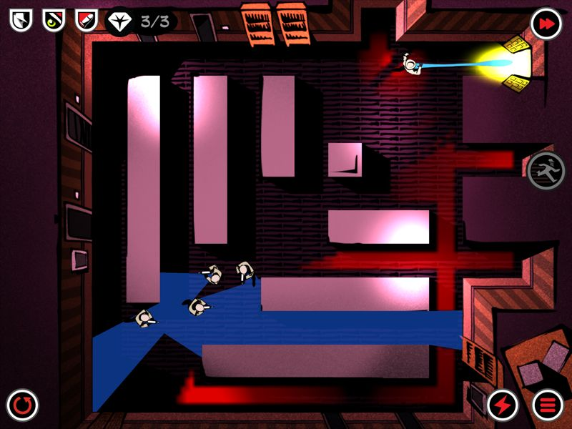
Occupancy Map: Overview
Run the propagation algorithm on the occupancy layer
Normalize the occupancy value after each propagation
The highest occupancy value is always 1.0
The tile with the highest occupancy value is the most likely location for the player
Need to find the closest tile to AI with1.0 influence value, to make sure AI searches the closer area first
If no tile has occupancy value >= 1.0 after normalizing, means there is no propagation
AI “loses” the player
AI should go back to its old behavior

Slide 64
Normalize Influence Values
Find highest influence value x
Divide all tiles with positive influence value by x
Ignore negative values, because it is used by enemy’s field of view
So the highest influence value of the map is always 1.0
0.23
0.25
0.23
0.25
0.70
0.23
0.23
0.25
0.25
0.23
0.25
0.23
0.25
0.70
0.23
0.23
0.25
0.25
0.33
0.36
0.33
0.36
1.00
0.33
0.33
0.36
0.36

Slide 65
Occupancy Map: Normalize Influence Value / Two Agents
Find highest positive influence value x and lowest negative influence value y
Divide all tiles with positive influence value by x
Divide all tiles with negative influence value by -y
So the highest influence value of the map is always 1.0, and the lowest is -1.0
0.23
0.25
0.23
-0.50
0.70
0.23
-0.25
0.25
0.25
0.23
0.25
0.23
-0.50
0.70
0.23
-0.25
0.25
0.25
0.33
0.36
0.33
-1.00
1.00
0.33
-0.50
0.36
0.36

Slide 66
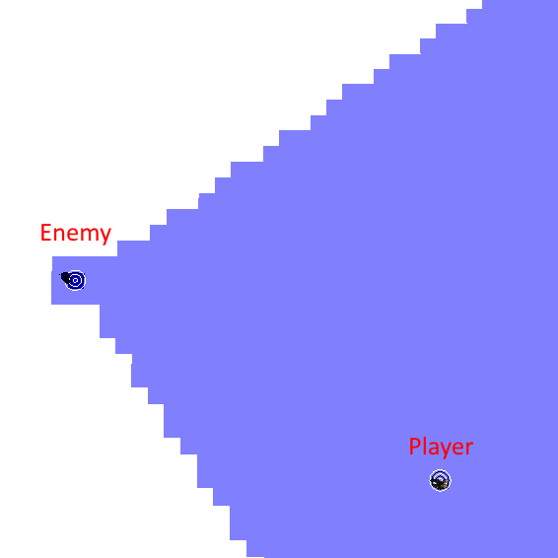
Occupancy Map: Field of View
Similar to the Search layer
Check if the tile is visible to the AI and it is within the viewing angle
But for all tiles that are close enough to the AI, do not check view angle
Still need to check if the AI is visible to the tile, to prevent AI from seeing through walls
Mark all tiles the AI can see with negative influence value
-0.50 : enemy alert
-0.25 : enemy patrol

Slide 67
Occupancy Map: Pseudo Code
Update occupancy with propagation algorithm on the temp layer, if value < 0.0, use 0.0
Apply FOV layer
Normalize the occupancy map, ignore all values <= 0.0
Store occupancy value from temp layer
0.33
0.36
0.33
0.36
1.00
0.33
-0.50
0.36
0.36
Occupancy Layer
0.00
0.00
0.00
0.00
0.00
0.00
0.00
0.00
0.00
Temp Layer

Slide 68
Occupancy Map: Pseudo Code
Update occupancy with propagation algorithm on the temp layer, if value < 0.0, use 0.0
Apply FOV layer
Normalize the occupancy map, ignore all values <= 0.0
Store occupancy value from temp layer
0.33
0.36
0.33
0.36
1.00
0.33
-0.50
0.36
0.36
Occupancy Layer
0.46
0.50
0.46
0.50
0.79
0.46
0.23
0.50
0.50
Temp Layer

Slide 69
Occupancy Map: Pseudo Code
Update occupancy with propagation algorithm on the temp layer, if value < 0.0, use 0.0
Apply FOV layer
Normalize the occupancy map, ignore all values <= 0.0
Store occupancy value from temp layer
0.33
0.36
0.33
0.36
1.00
0.33
-0.50
0.36
0.36
0.33
0.36
0.33
0.36
1.00
0.33
-0.50
0.36
0.36
Occupancy Layer
0.46
0.50
0.46
0.50
0.79
0.46
0.23
0.50
0.50
0.46
0.50
0.46
-0.50
0.79
0.46
-0.50
-0.50
0.50
Temp Layer

Slide 70
Occupancy Map: Pseudo Code
Update occupancy with propagation algorithm on the temp layer, if value < 0.0, use 0.0
Apply FOV layer
Normalize the occupancy map, ignore all values <= 0.0
Store occupancy value from temp layer
0.33
0.36
0.33
0.36
1.00
0.33
-0.50
0.36
0.36
0.33
0.36
0.33
0.36
1.00
0.33
-0.50
0.36
0.36
0.33
0.36
0.33
0.36
1.00
0.33
-0.50
0.36
0.36
Occupancy Layer
0.46
0.50
0.46
0.50
0.79
0.46
0.23
0.50
0.50
0.46
0.50
0.46
-0.50
0.79
0.46
-0.50
-0.50
0.50
0.58
0.63
0.58
-0.50
1.00
0.58
-0.50
-0.50
0.63
Temp Layer

Slide 71
Occupancy Map: Pseudo Code
Update occupancy with propagation algorithm on the temp layer, if value < 0.0, use 0.0
Apply FOV layer
Normalize the occupancy map, ignore all values <= 0.0
Store occupancy value from temp layer
0.33
0.36
0.33
0.36
1.00
0.33
-0.50
0.36
0.36
0.33
0.36
0.33
0.36
1.00
0.33
-0.50
0.36
0.36
0.33
0.36
0.33
0.36
1.00
0.33
-0.50
0.36
0.36
0.58
0.63
0.58
-0.50
1.00
0.58
-0.50
-0.50
0.63
Occupancy Layer
0.46
0.50
0.46
0.50
0.79
0.46
0.23
0.50
0.50
0.46
0.50
0.46
-0.50
0.79
0.46
-0.50
-0.50
0.50
0.58
0.63
0.58
-0.50
1.00
0.58
-0.50
-0.50
0.63
0.58
0.63
0.58
-0.50
1.00
0.58
-0.50
-0.50
0.63
Temp Layer

Slide 72
Occupancy Map: AI Logic for Hide and Seek
Compute FOV layer
If AI sees the player (player’s tile has negative occupancy value), behavior : RUN TO PLAYER
Pick the player’s position as goal
If the AI can’t see the player, behavior : SEEK PLAYER
If the player moves out of sight, use its last known position to start propagation
Update occupancy map
Pick the closest tile with 1.0 occupancy value as goal
If no tile has 1.0 occupancy value, AI loses the player
If AI loses player, behavior : PATROL
AI picks a random position within certain distance as goal, and walk to it

Slide 73
Project 3: Terrain Analysis & Occupancy Map

Slide 74
Project 3: Terrain Analysis & Occupancy Map
Due in 2 weeks
Same base code as Project 2
No sharing code on this assignment

Slide 75
Project 3: Grading (1)
Terrain Analysis:
(15%) Openness Closest Wall
(15%) Visibility
(15%) Visible to Player (with 50% sniper spots)
(15%) Search

Slide 76
Project 3: Grading (2)
Occupancy Map:
(20%) Propagation + Normalize Occupancy
(5%) Field of View (Hide and Seek)
(5%) Find Player (Hide and Seek)
(10%) Seek Player (Hide and Seek)

Slide 77
Project 3: Grading (3)
Project 2:
(-10%) If it crashes at any time
(0 to -100%) Project 2 requirements regraded (except time req)
(extra credit) All Project 2 extra credit still available
Detailed instruction in Project3_Instruction.docx.

Slide 78
Terrain Analysis & Occupancy Map
Reference:
The Mechanics of Influence Mapping: Representation, Algorithm & Parameters
By Alex J. Champandard on May 19, 2011
http://aigamedev.com/open/tutorial/influence-map-mechanics/

Slide 79
A* uses Analysis
When calculating the given cost, add additional:
if(useAnalysis)
{
givenCost += g_terrain.GetInfluenceMapValue(row, col) * 20;
}
Don’t forget to multiply influence value by 20.

